Slide 1
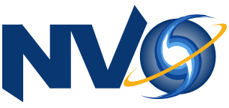
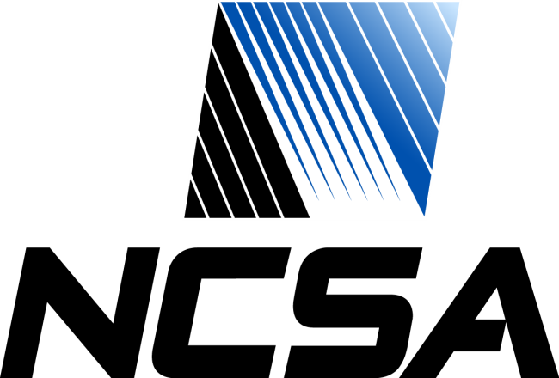
Virtual Observatory Single Sign-on
U.S. National Virtual Observatory
National Center for Supercomputing Applications
Ray Plante, Bill Baker

Slide 2

What is the Virtual Observatory?
Network-based environment for doing astronomical research
Worldwide federation of archives and services
Interoperate using standards
Standards body: International Virtual Observatory Alliance
A community of separately-funded projects
U.S. National Virtual Observatory
15 other national VOs

Slide 3
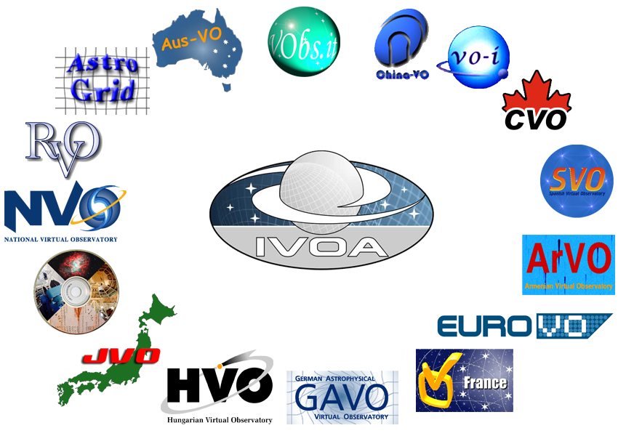
What is the Virtual Observatory?

Slide 4
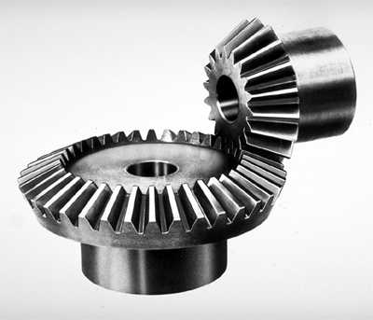
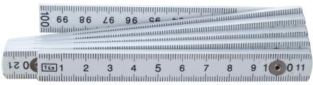
Virtual Observatory Standards www.ivoa.net/Documents
Data Models and Formats
Images, Spectra, Tables
Metadata, Catalogs
Service Protocols
Data Discovery and Access
Authentication
Analysis services
Remote Storage

Slide 5
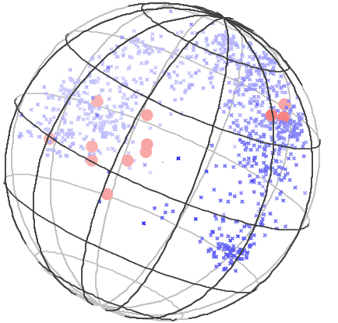
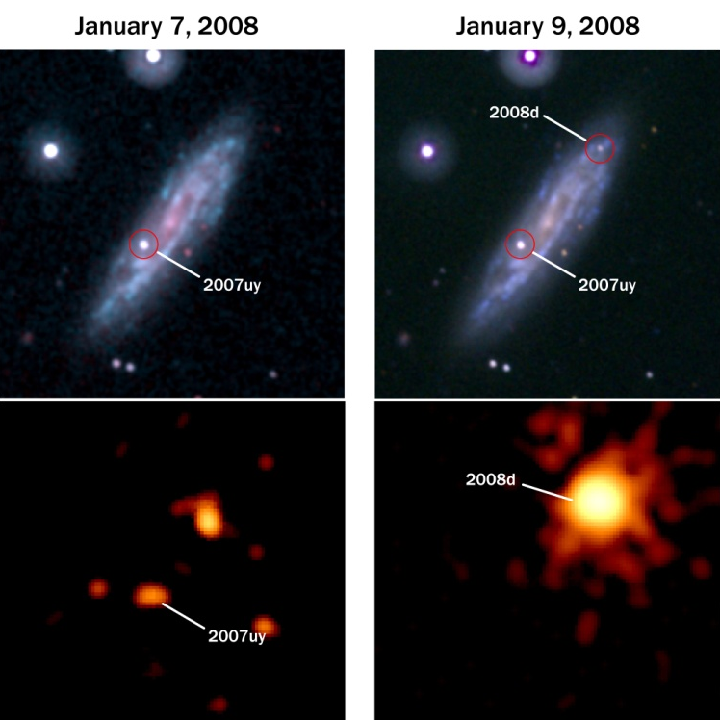
Virtual Observatory Services www.us-vo.org
Data Discovery—What’s available?
Registry: Search based on subject
DataScope: Search by sky position
Open Sky Server: Cross-correlation of catalogs
Data Access
Common interfaces for searching contents of archives
Portals
Provide friendly browser-based access to services

Slide 6
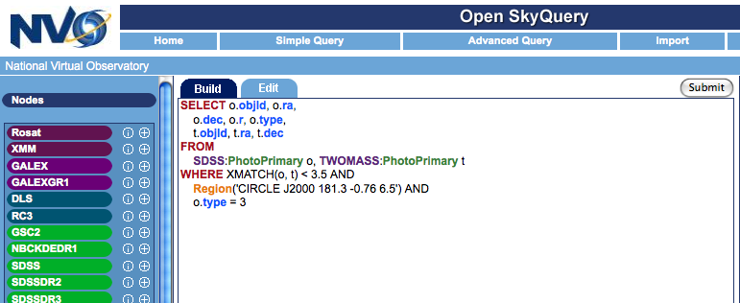
Virtual Observatory Portals
There are many portals
Each specialized for a target community
Distributed; managed by a variety of institutions
Most resources are open & free
Some are not
for example 1-year proprietary period
But users want the same tools for open and proprietary data, and to mix data
Users derive new proprietary datasets
Need secure remote storage
VO
TAP
Remote
Science
Database
VOSpace
Remote
Storage

Slide 7
Centralized Authentication
Simple for Users
Single identity for multiple services
Supports Developers
Provide toolkit, documentation, support
Built-in security (don’t have to worry about mistakes; never see password)
Facilitates Community
Share user identity among services and portals
Interoperate smoothly with open resources
Delegation to enable complex workflows
VO
TAP
Remote
Science
Database
VOSpace
Remote
Storage

Slide 8

Authentication Issues
Weak vs. Strong
Weak authn: I am the same person each time
Strong authn: I really am who I claim to be
Rely on existing ID verification systems
Privacy
Give users control over what to share with portals
Developers, developers
Goal: Foster the creation of portals and services

Slide 9

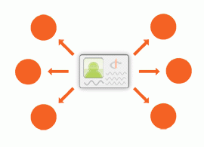
Web Sign-on Mechanisms
Pubcookie (Web SSO Software)
Web SSO; NCSA added MyProxy integration
Mature but not standards-based
Apache or IIS module (requires root)
OpenID
Standard; Gaining widespread adoption
Many toolkits exist; doesn’t require web server integration
NVO is in Alpha, rolling out to first customer soon (still need to implement credential delegation though)

Slide 10

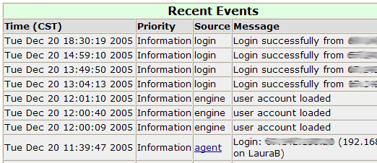
Web Sign-on Auxiliaries
Registration
PuRSe—evolved, re-written, patched
Provides user services (password reminder, etc.)
Logging (Under Development)
To take the place of old local authentication logs
Privacy—admins should only see “their” users
Correlation—track a user’s path through invitation, registration, confirmation, login

Slide 11
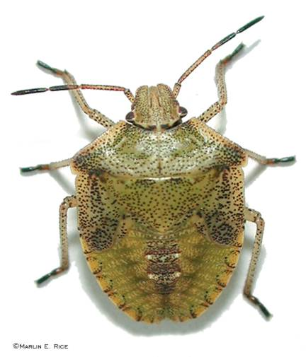

Lessons Learned
Toolkits are important
Pubcookie can be hard to debug
Globus is big to install—our devs prefer a self-contained MyProxy client
People like their languages: OpenID is available in Perl, Python, Java, C, Ruby …
High Availability
Never be down when a portal is up
Redundancy is hard work

Slide 12

Lessons Learned
Need logging—accessible, expressive, private
For every production server, there are several development servers to support
Most portals only need identity
We are still getting used to it “I went to a DES URL but got an NVO login page”

Slide 13

Work in Progress
Smoothing out OpenID wrinkles
Delegation
User Interface
Library Support
Implementing Logging Service
Questions / Comments?

